Slide 1
WEEKLY CUSTOMER RETENTION
2020-11-01 – 2021-01-31

Slide 2
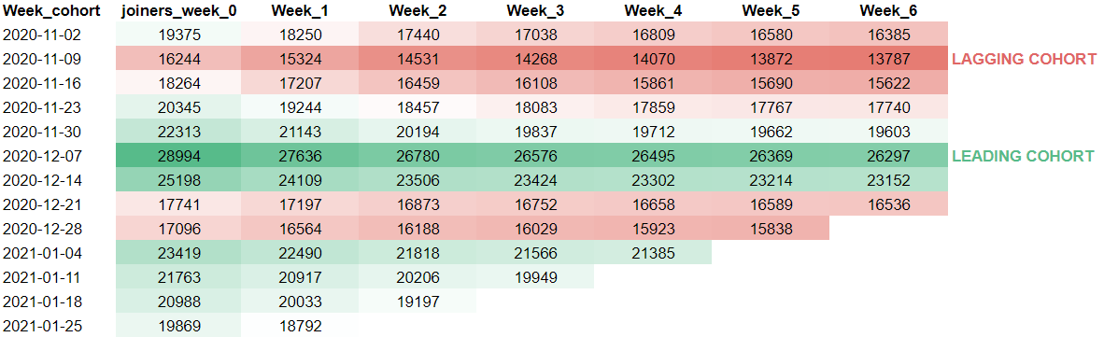
CUSTOMERS GAINED & RETAINED

Slide 3
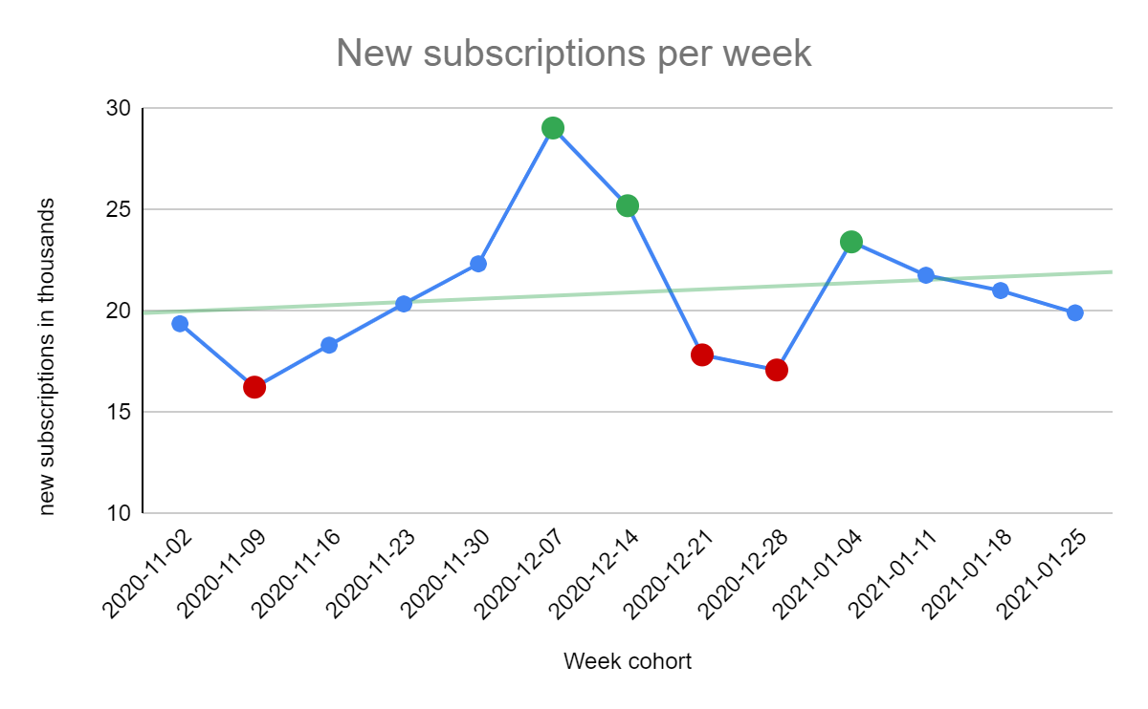
new subscriptions WEEKLY
INCREASING
Overall growing trend of new subscriptions

Slide 4
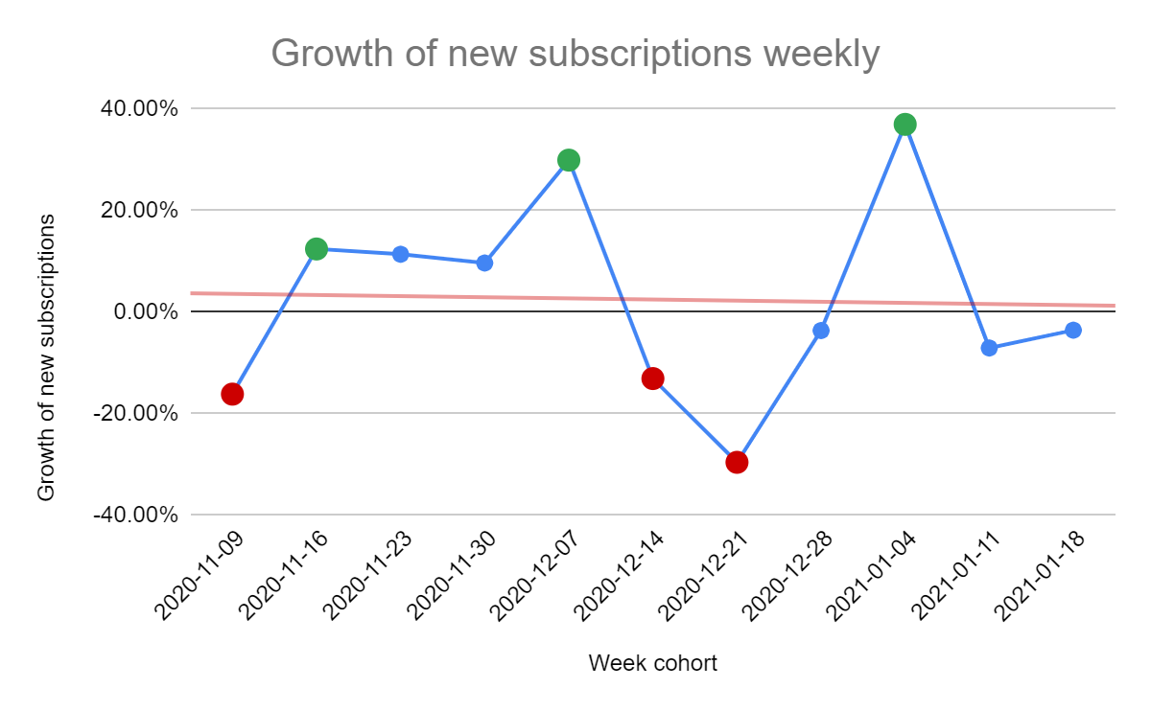
WEEKLY GROWTH OF SUBS
declining
Overall decreasing trend of new subscriptions growth

Slide 5
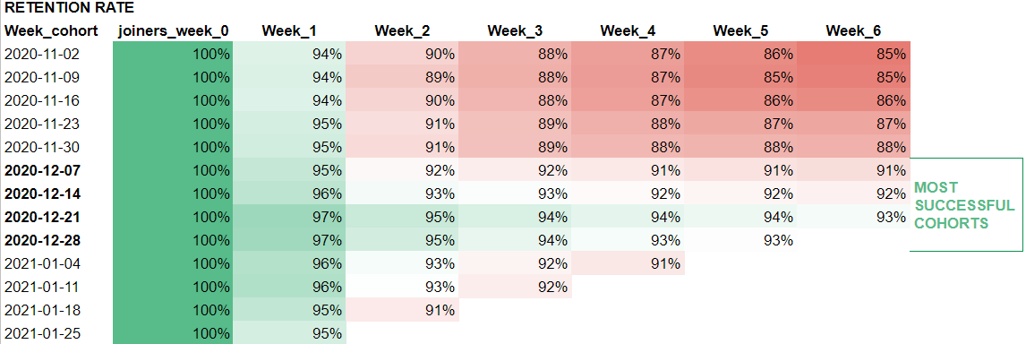
RETENTION RATE

Slide 6
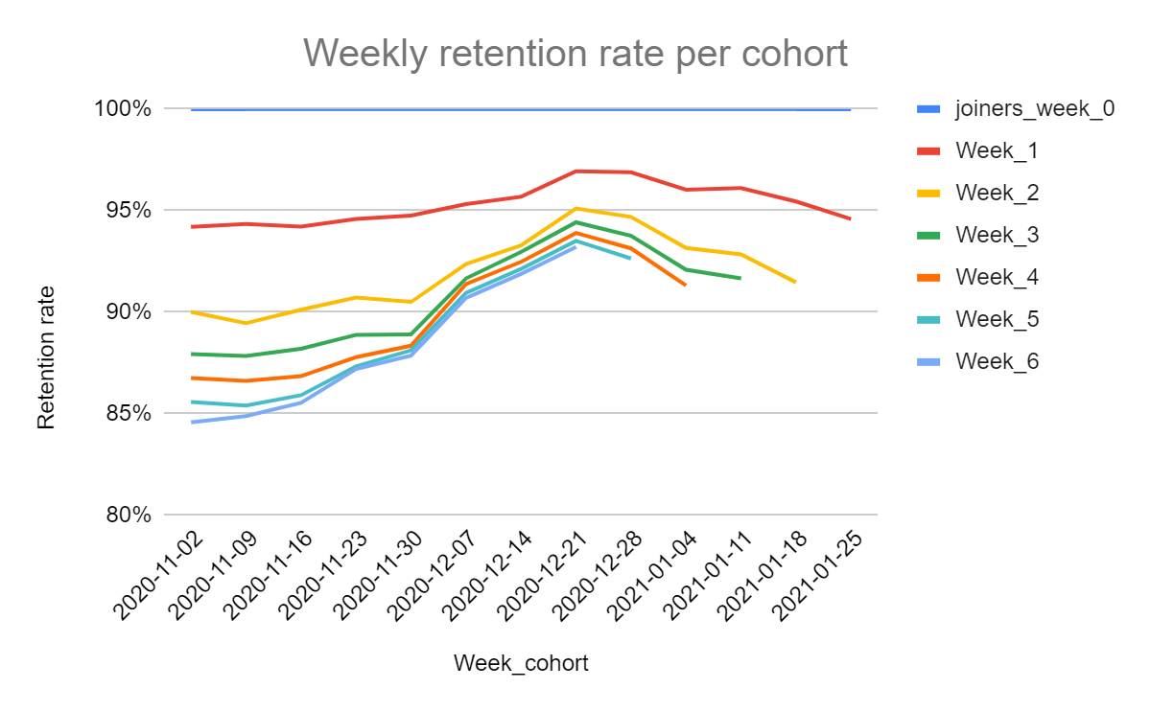
COHORTS COMPARED

Slide 7
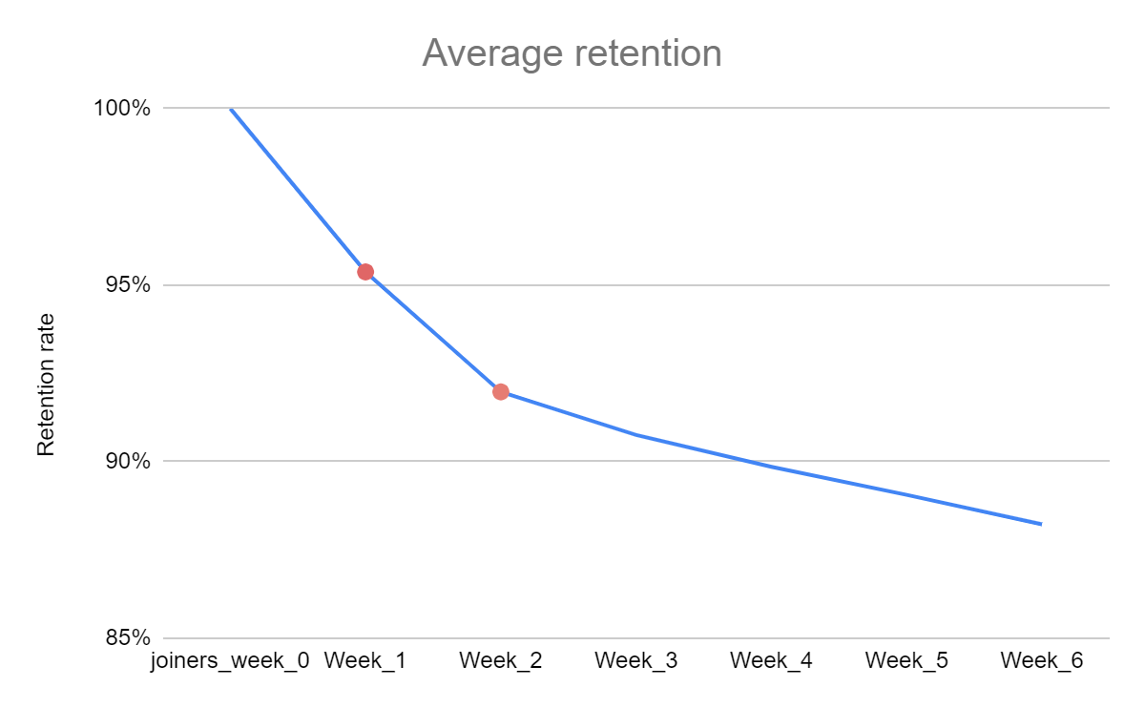
AVERAGE RETENTION
WEEK 1 & WEEK 2
Most critical weeks when highest number of customers churn

Slide 8
CONCLUSIONS & RECOMMENDATIONS
Use ad campaigns/improvements from 2020 Dec Week 1-2 and 2021 Jan Week 1-2 as a reference point. These cohorts attracted the most new customers.
Even though number of attracted customer is growing, the growth is shrinking. Improve competitive position – upgrades, matching market trends, increasing service quality.
December cohorts maintained the best customer retention rate. Use onboarding similar to the one applied for December cohort customers.
Customers are most likely to churn during the first and second week of subscription. Increase customer interaction during week 1 & 2 of usage.

